Slide 1


HTML5 APIs and JavaScript Integration
Presenter: Tech Expert

Slide 2


Content
1. Understanding HTML5 APIs
2. Geolocation API
3. Web Storage API
4. Best Practices and Considerations

Slide 3


Section 1
Understanding HTML5 APIs

Slide 4



Introduction to HTML5 APIs
01
02
03
Definition of HTML5 APIs
Key Features and Benefits
Integration with JavaScript
HTML5 APIs are built-in JavaScript interfaces that allow developers to access and manipulate web browser features, enhancing the functionality of web applications.
These APIs provide capabilities such as local storage, geolocation, and multimedia handling, enabling richer user experiences and more interactive applications.
HTML5 APIs are designed to work seamlessly with JavaScript, allowing developers to create dynamic web applications that can respond to user actions and environmental changes in real-time.

Slide 5

Importance of APIs in Web Development
Enhancing Functionality
APIs allow developers to integrate complex functionalities, such as geolocation and data storage, without needing to build these features from scratch, significantly speeding up the development process.
Facilitating Communication
APIs serve as intermediaries that enable different software systems to communicate effectively, allowing web applications to interact with external services and databases seamlessly.
Promoting Innovation
By leveraging existing APIs, developers can focus on creating unique features and improving user experiences, fostering innovation and creativity in web development projects.

Slide 6




Overview of Geolocation and Web Storage APIs
Geolocation API Functionality
Web Storage Mechanisms
Security and Privacy Considerations
HTML5 provides two types of web storage: localStorage for persistent data storage across sessions and sessionStorage for temporary data that lasts only while the browser tab is open, enhancing user experience by retaining state information.
The Geolocation API allows web applications to access the geographical location of a user, enabling features like location-based services, mapping, and personalized content delivery based on user proximity.
When using the Geolocation API, developers must handle user permissions carefully and ensure that sensitive location data is protected, while with Web Storage, it's crucial to avoid storing sensitive information due to potential security vulnerabilities.

Slide 7
How APIs Enhance User Experience
01
02
03
Personalized User Interactions
Seamless Data Management
Dynamic Content Updates
APIs like the Geolocation API allow applications to tailor content and services based on the user's location, enhancing relevance and engagement through personalized experiences.
The Web Storage API enables efficient client-side data storage, allowing users to maintain their preferences and session states, which leads to a smoother and more consistent user experience across sessions.
By integrating APIs with JavaScript, developers can create applications that respond in real-time to user actions or environmental changes, providing instant feedback and improving overall interactivity.

Slide 8
Section 2
Geolocation API

Slide 9



What is the Geolocation API?
Definition and Purpose
Functionality Overview
User Permissions
The Geolocation API is a web API that allows developers to access the geographical location of a user's device, enabling applications to provide location-based services and features.
It provides methods to retrieve the user's current position, watch for changes in position, and handle errors related to location retrieval, making it essential for applications like maps and navigation.
The API requires user consent to access location data, ensuring privacy and security; developers must implement proper permission handling to enhance user trust and comply with regulations.

Slide 10
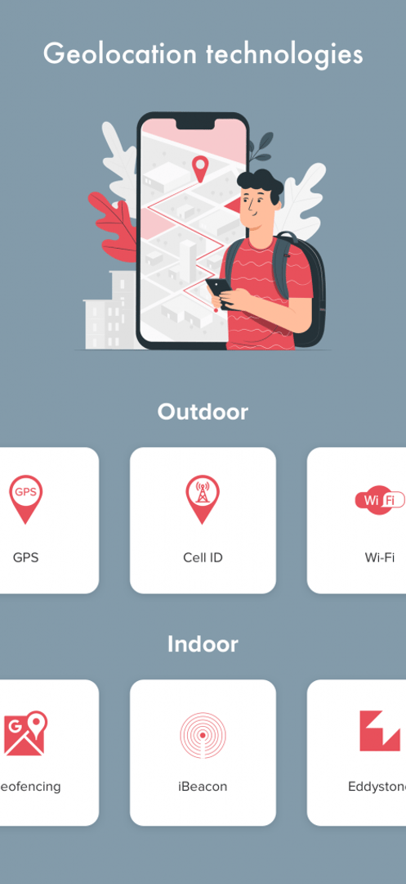
Use Cases for Geolocation API
Location-Based Services
The Geolocation API enables applications to provide personalized services based on the user's current location, such as finding nearby restaurants, stores, or attractions, enhancing user engagement and satisfaction.
Real-Time Navigation
By integrating the Geolocation API with mapping services, developers can create real-time navigation applications that guide users with turn-by-turn directions, traffic updates, and estimated arrival times, improving travel efficiency.
Geofencing Applications
The API allows for the creation of geofencing features that trigger notifications or actions when a user enters or exits a predefined geographic area, useful for marketing campaigns and location-based alerts.

Slide 11
Implementing Geolocation in Your Application
01
02
03
Understanding Geolocation API
User Consent and Privacy
Error Handling and Fallbacks
The Geolocation API provides a straightforward way to access a user's geographical location, enabling developers to create applications that can offer location-specific features such as mapping, local weather updates, and nearby service recommendations.
Implementing geolocation requires obtaining user permission to access their location data. Developers must ensure that they handle permissions transparently and respect user privacy by providing clear information on how the data will be used.
When implementing geolocation, it's crucial to include error handling for scenarios where location access is denied or unavailable. Providing fallback options, such as manual location input or default settings, enhances user experience and application reliability.

Slide 12

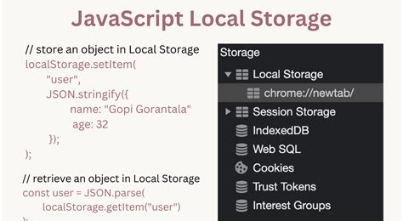

Example Code and Explanation
Geolocation API Example
Web Storage API Usage
Error Handling in APIs
The provided code snippet demonstrates how to use the Geolocation API to retrieve the user's current geographical position. It checks if geolocation is supported, then calls getCurrentPosition to fetch the latitude and longitude, displaying them in an HTML element.
This example illustrates how to utilize localStorage to store a username. The code sets an item in local storage and retrieves it to display on the webpage, showcasing how data can persist across sessions using the Web Storage API.
When implementing these APIs, it's essential to include error handling mechanisms. For the Geolocation API, developers should manage cases where location access is denied or unavailable, while for Web Storage, they should ensure that data retrieval does not fail silently, enhancing overall application robustness.

Slide 13
Section 3
Web Storage API

Slide 14

Introduction to Web Storage API
Overview of Web Storage
The Web Storage API provides a simple and efficient way to store data on the client side, allowing web applications to save key-value pairs in a web browser, enhancing user experience by retaining information across sessions.
Types of Storage
It consists of two main types: localStorage, which retains data indefinitely until explicitly deleted, and sessionStorage, which stores data only for the duration of the page session, making it ideal for temporary data needs.
Use Cases and Benefits
Common use cases include saving user preferences, maintaining session states, and caching data for offline access, which collectively improve application performance and user engagement by minimizing server requests.

Slide 15



Differences Between localStorage and sessionStorage
Data Persistence Duration
Scope of Accessibility
Use Cases and Best Practices
localStorage retains data even after the browser is closed, allowing for long-term storage, while sessionStorage only keeps data for the duration of the page session, meaning it is cleared when the tab or browser is closed.
Data stored in localStorage is accessible across all tabs and windows of the same origin, enabling a consistent user experience, whereas sessionStorage is limited to the specific tab or window where it was created, isolating data between sessions.
localStorage is ideal for storing user preferences and settings that should persist across sessions, while sessionStorage is best suited for temporary data such as form inputs or session-specific information that does not need to be retained after the user leaves the page.

Slide 16
Practical Applications of Web Storage
01
02
03
User Preferences Storage
Session Management
Offline Data Caching
Utilizing sessionStorage, developers can maintain user session states, such as login status or form data, which improves usability by preventing data loss during navigation and providing a seamless experience within a single session.
Web Storage can be employed to cache essential data for offline access, enabling applications to function without an internet connection. This is particularly useful for mobile applications and progressive web apps (PWAs) that require reliable performance in varying network conditions.
Web Storage allows developers to save user preferences, such as theme settings or language choices, ensuring a personalized experience that persists across sessions, enhancing user satisfaction and engagement.

Slide 17
Example Code and Explanation
Web Storage API Overview
The Web Storage API provides two storage options, localStorage and sessionStorage, allowing developers to store data in key-value pairs on the client side, enhancing user experience by retaining information across sessions or during a single session.
Example Code for localStorage
The example code demonstrates how to use localStorage to save a username. By calling localStorage.setItem('username', 'JohnDoe'), the username is stored persistently, and it can be retrieved later using localStorage.getItem('username'), showcasing the simplicity of data management.
Practical Use Cases
Common applications of the Web Storage API include saving user preferences, maintaining session states, and caching data for offline access, which collectively improve application performance and user engagement by minimizing server requests and enhancing personalization.

Slide 18
Section 4
Best Practices and Considerations

Slide 19


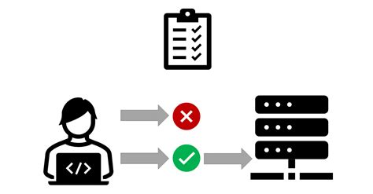
Security Considerations for Using APIs
User Data Protection
Permission Management
Input Validation and Sanitization
Ensure that sensitive user data, such as location or personal information, is encrypted during transmission and storage to prevent unauthorized access and data breaches.
Implement robust permission handling to request user consent transparently, explaining how their data will be used, which builds trust and complies with privacy regulations like GDPR.
Always validate and sanitize inputs received from APIs to protect against injection attacks and ensure that only expected data formats are processed, reducing the risk of security vulnerabilities.

Slide 20
Performance Optimization Tips
Minimize API Calls
Reduce the number of API calls by batching requests or using caching strategies to store frequently accessed data, which can significantly enhance application performance and reduce latency.
Optimize Data Handling
Use efficient data structures and algorithms when processing data from APIs, ensuring that operations are performed in a time-efficient manner to improve responsiveness and user experience.
Leverage Asynchronous Operations
Implement asynchronous programming techniques, such as Promises or async/await, to prevent blocking the main thread during API interactions, allowing for smoother user interactions and better overall application performance.

Slide 21
Future of HTML5 APIs in Web Development
01
02
03
Emerging API Standards
Increased Focus on Performance
Integration with AI and IoT
The future of HTML5 APIs will likely see the establishment of new standards that enhance interoperability and security, enabling developers to create more robust applications that can seamlessly integrate with various platforms and devices.
As web applications become more complex, future HTML5 APIs will prioritize performance optimization, including faster data retrieval methods and reduced latency, ensuring a smoother user experience even under heavy loads.
The evolution of HTML5 APIs will increasingly incorporate artificial intelligence and Internet of Things (IoT) capabilities, allowing developers to build smarter applications that can respond to user behavior and environmental changes in real-time.

Slide 22
Thank You
Contact: tech.expert@example.com

